Slide 1
COVID-19 Statistics
12-04-2020

Slide 2
Latest Statistics
(updated 12-04-2020)
Total confirmed cases worldwide: 1,845,958
75,165 new cases (4% increase)
Total fatal cases worldwide: 114,078
5,588 new fatalities (5% increase)
Israel recorded 11,145 cases in total
increased by 402 cases (3% increase)
18.0# in confirmed cases, 37.0# in mortality
20.0# in cases per capita, 37.0# in mortality rate

Slide 3
Latest Statistics
(updated 12-04-2020)
Worldwide mortality rate: 6.2% (+0.1%)
Israel mortality rate: 0.9% (-0.0%)
US has most cases in total (555,313)
US has most fatal cases in total (US)
US recorded the most new cases (28,917)
US recorded the most new fatal cases (1,557)

Slide 4
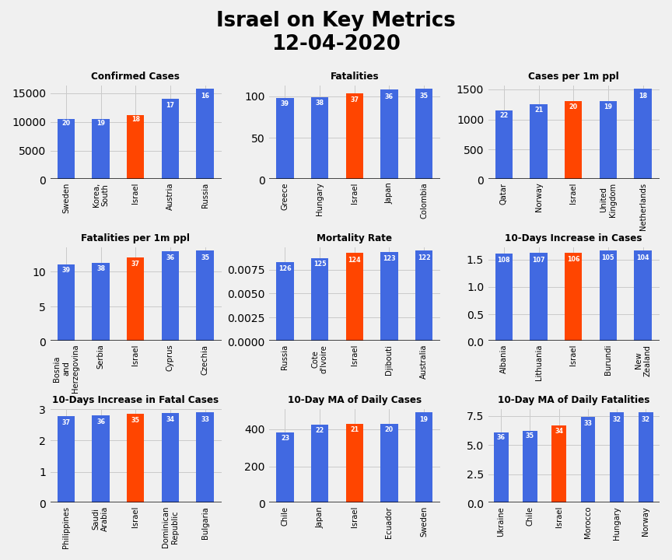
Israel on Key Metrics

Slide 5
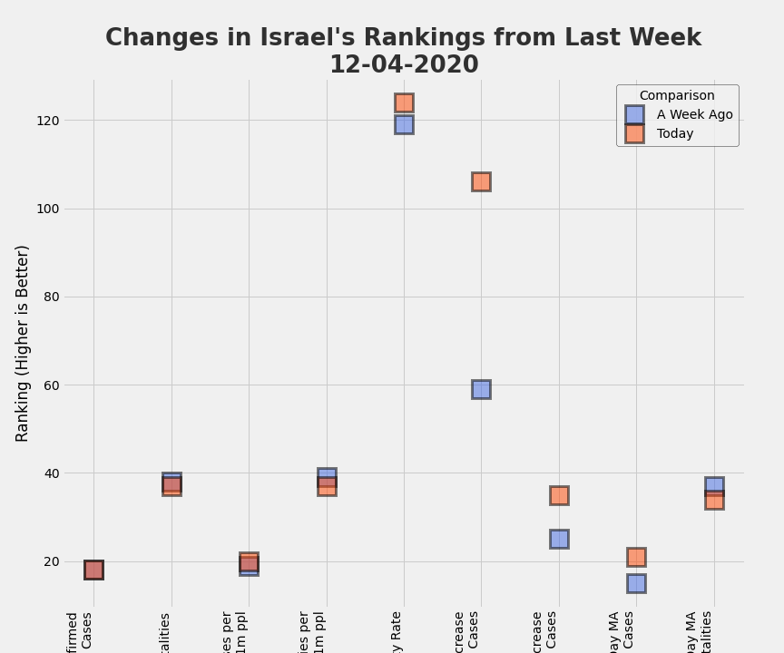
Changes in Israel's Rankings from Last Week

Slide 6
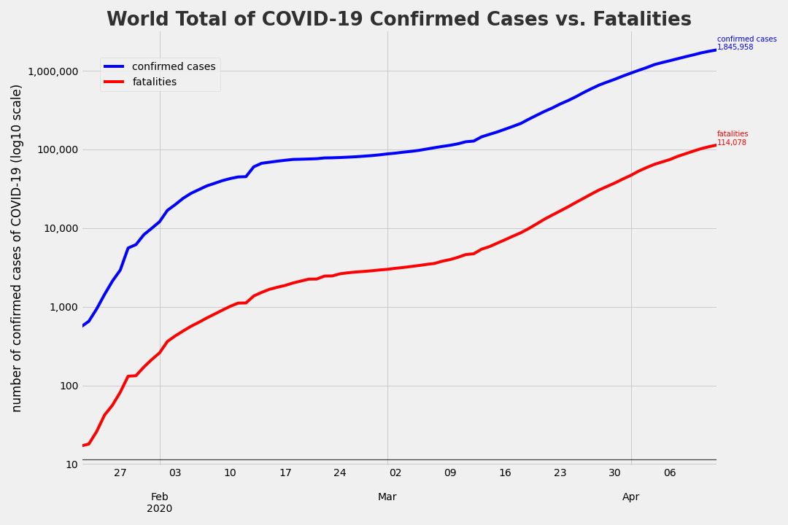
COVID-19 confirmed cases vs COVID-19 fatalities

Slide 7
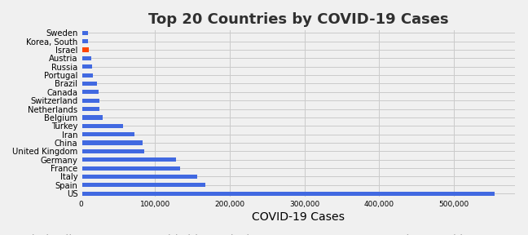
Top 20 Countries by COVID-19 Cases

Slide 8
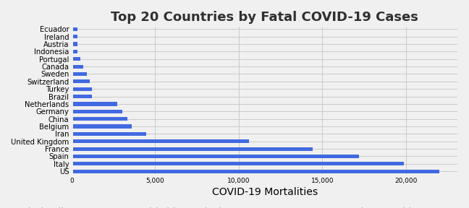
Top 20 Countries by Fatal COVID-19 Cases

Slide 9
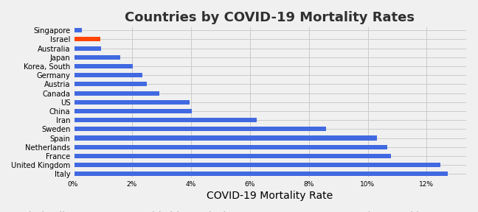
Countries by COVID-19 Mortality Rates

Slide 10
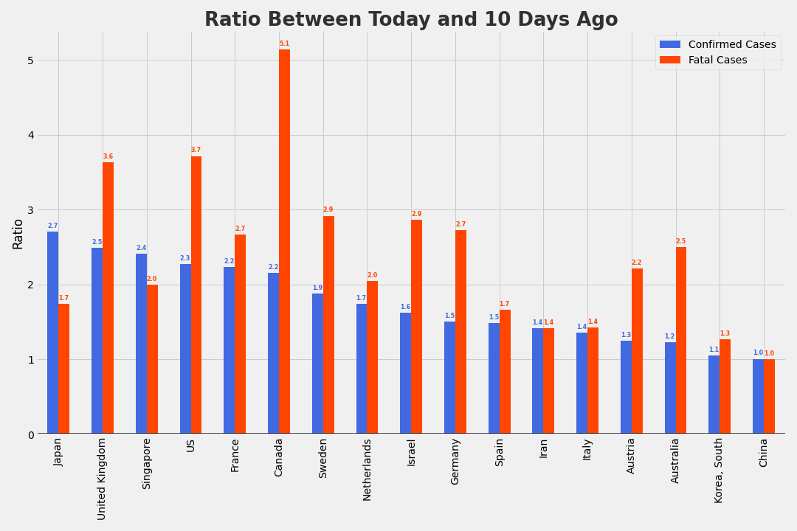
Ratio Between Today and 10 Days Ago

Slide 11
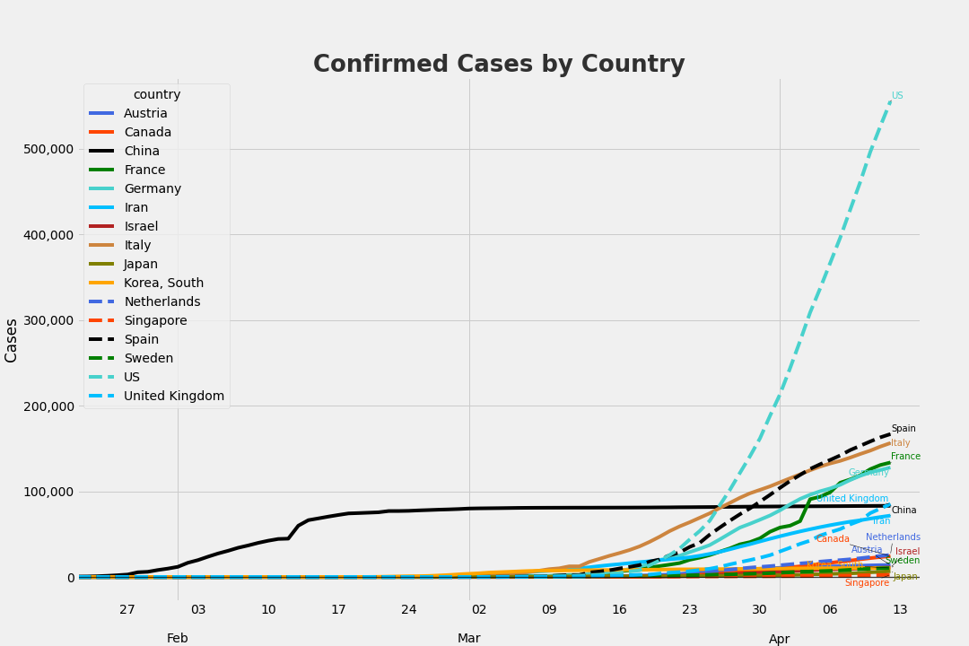
Confirmed Cases by Country

Slide 12
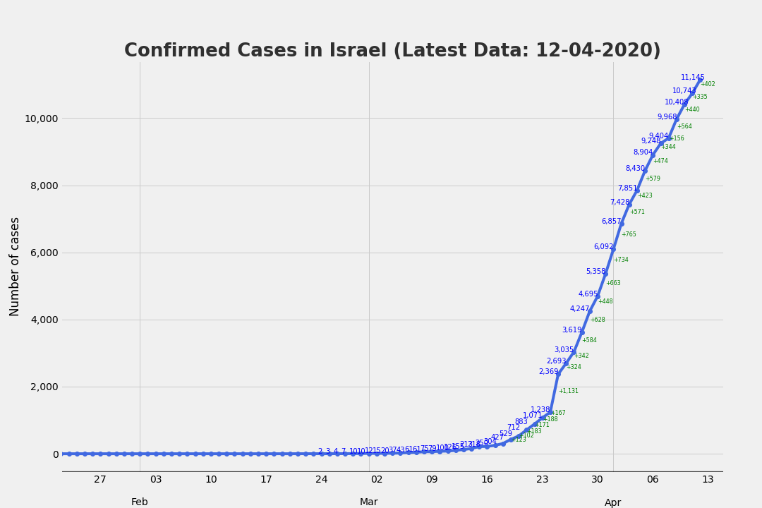
Confirmed Cases in Israel

Slide 13
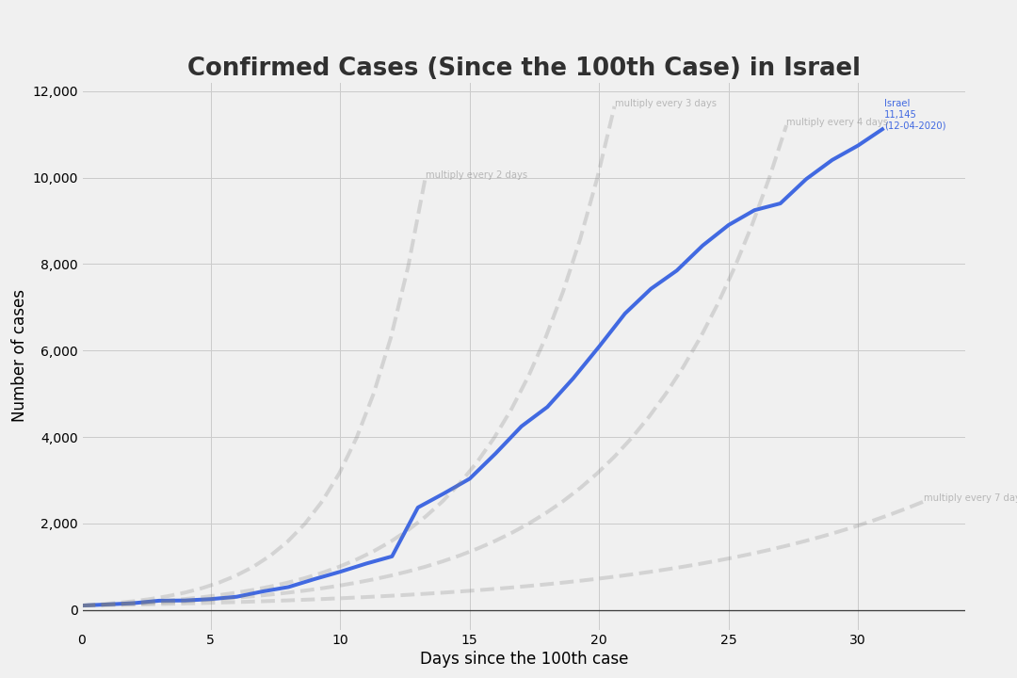
Confirmed Cases in Israel
Since the 100th Case

Slide 14
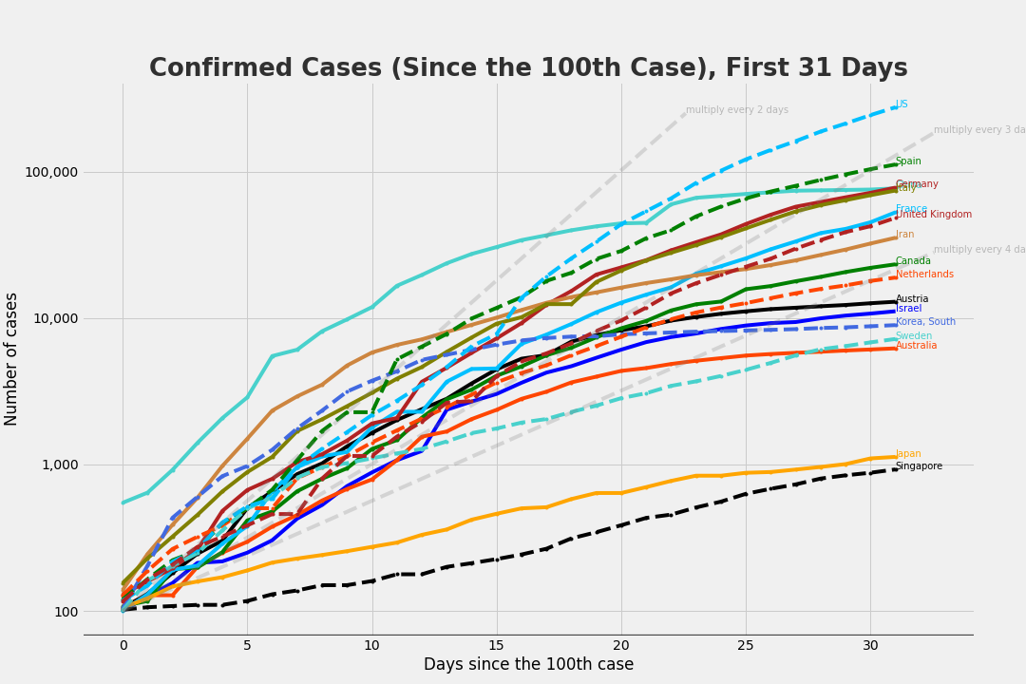
Confirmed Cases
Since the 100th Case, First 31 Days

Slide 15
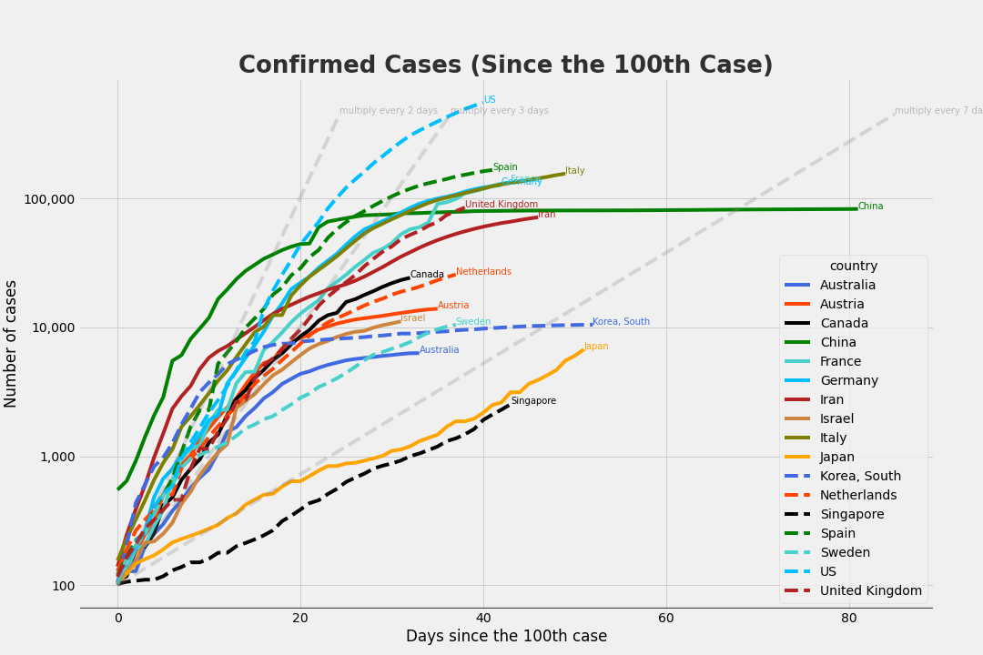
Confirmed Cases
Since the 100th Case

Slide 16
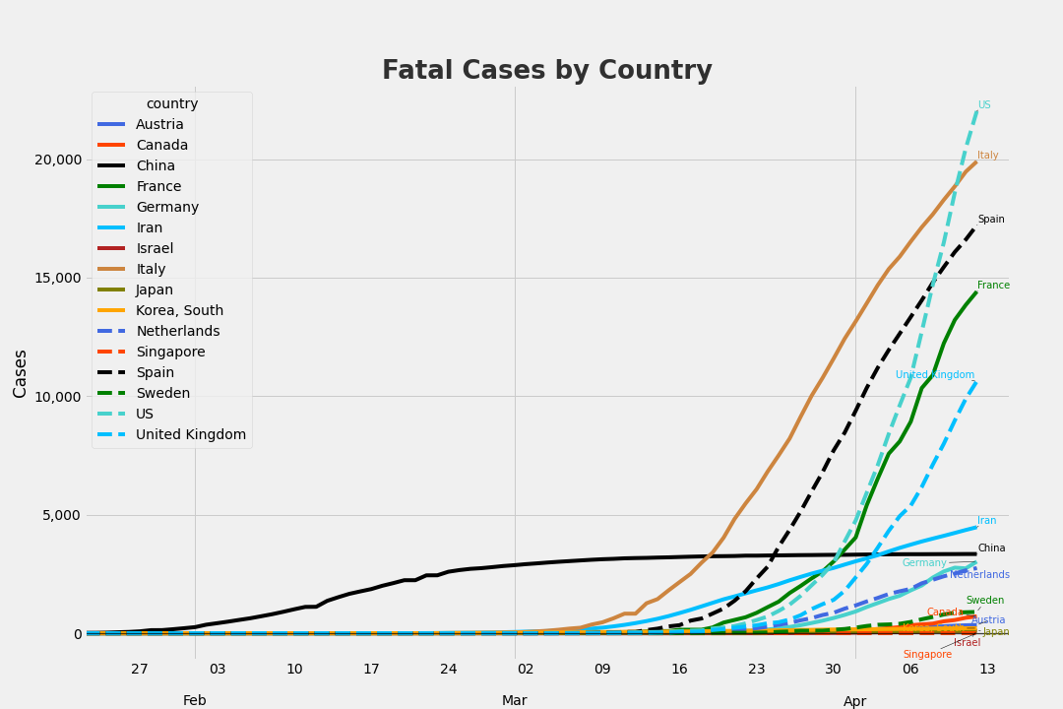
Fatal Cases by Country

Slide 17
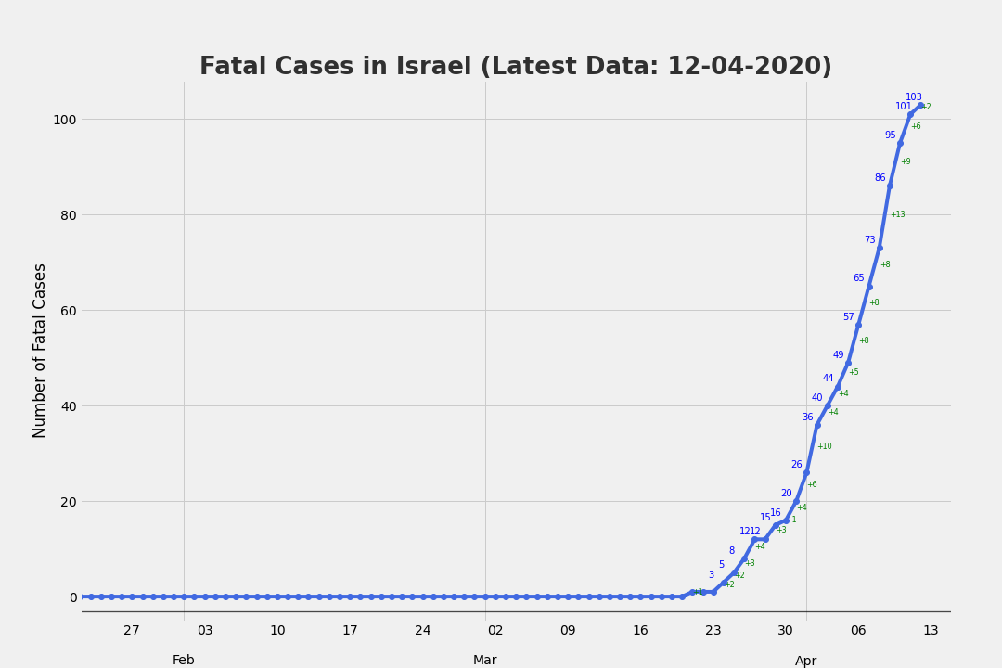
Fatal Cases in Israel

Slide 18
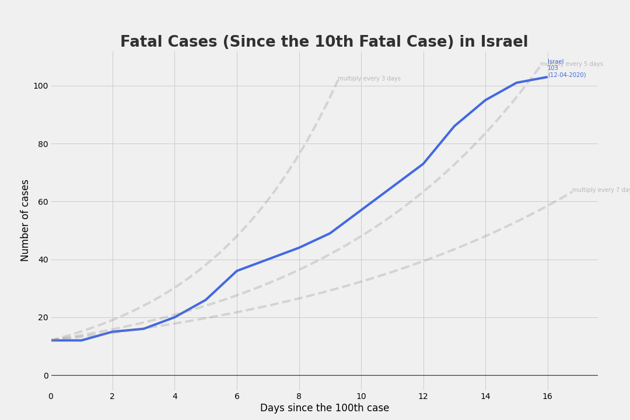
Fatal Cases in Israel
Since the 100th Case

Slide 19
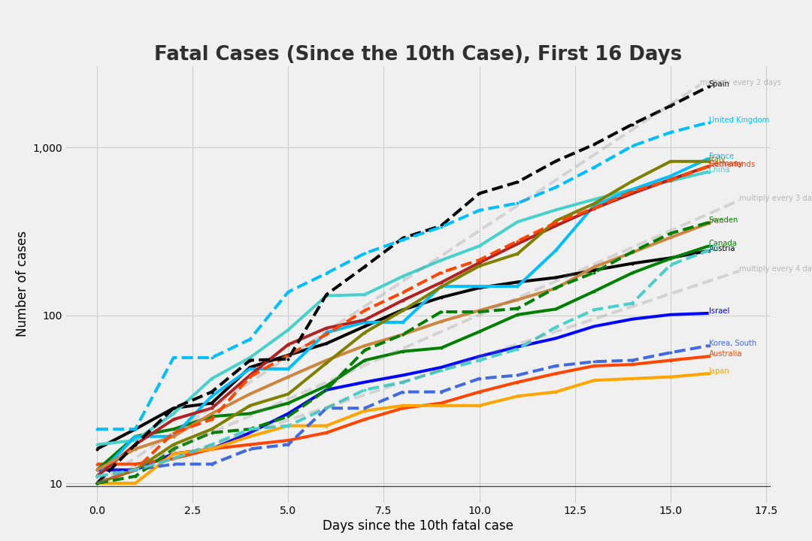
Fatal Cases
Since the 10th Case, First 16 Days

Slide 20
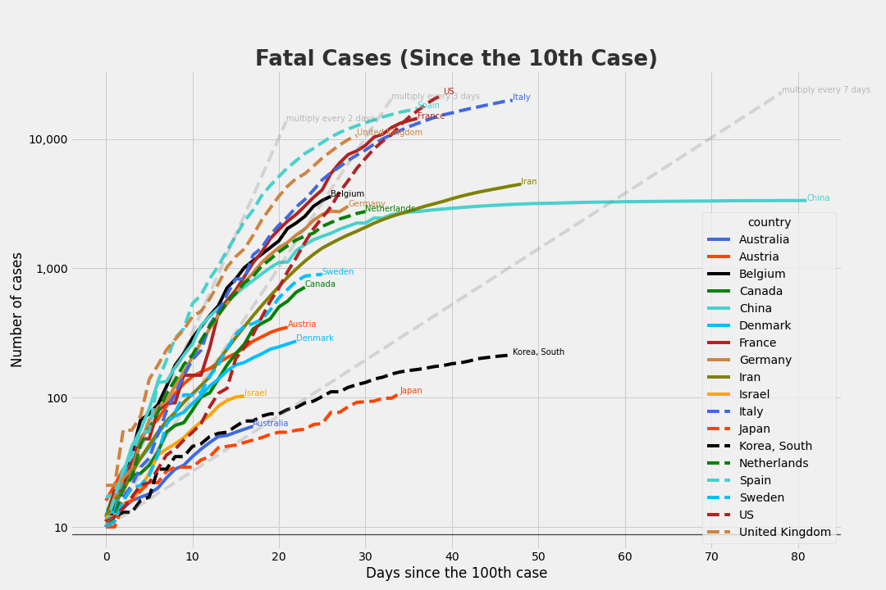
Fatal Cases
Since the 10th Case

Slide 21
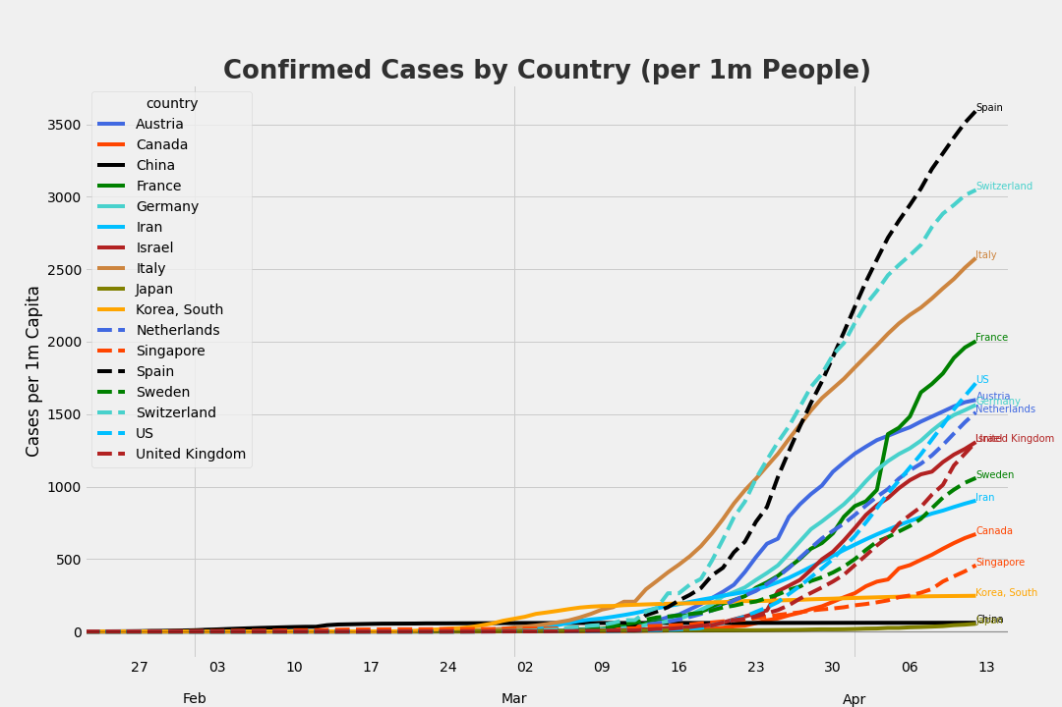
Confirmed Cases by Country
per 1m People

Slide 22
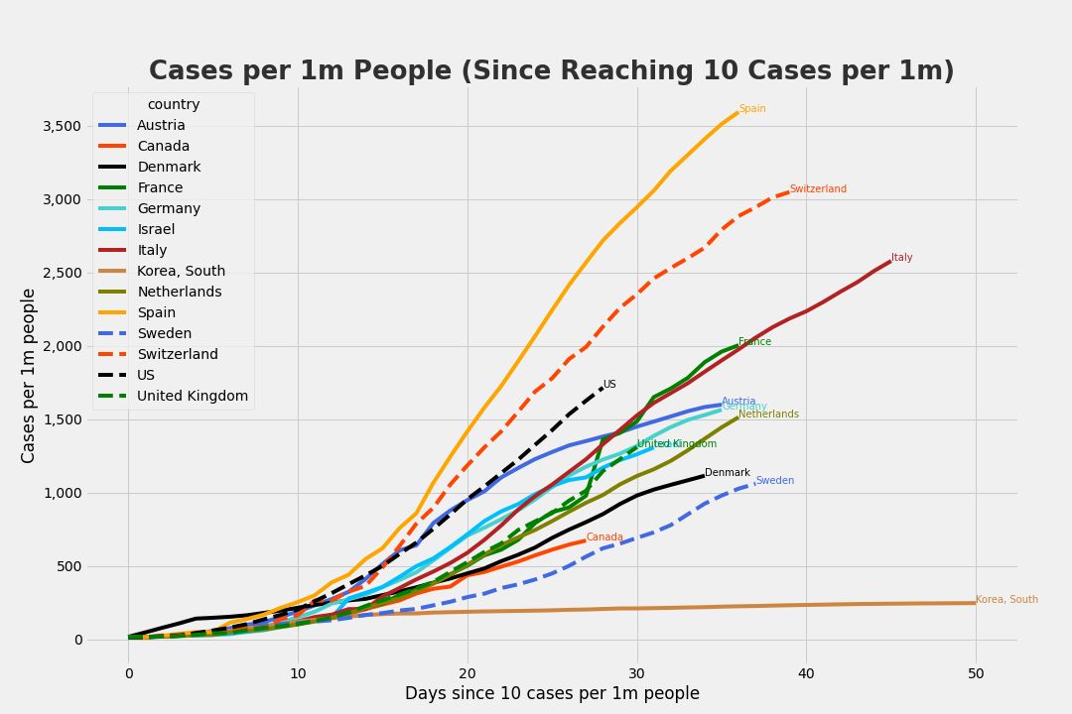
Cases per 1m People
Since Reaching 10 Cases per 1m

Slide 23
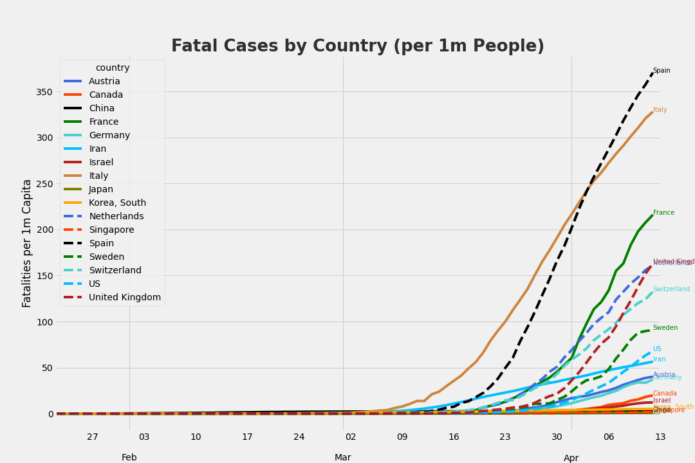
Fatal Cases by Country
per 1m People

Slide 24
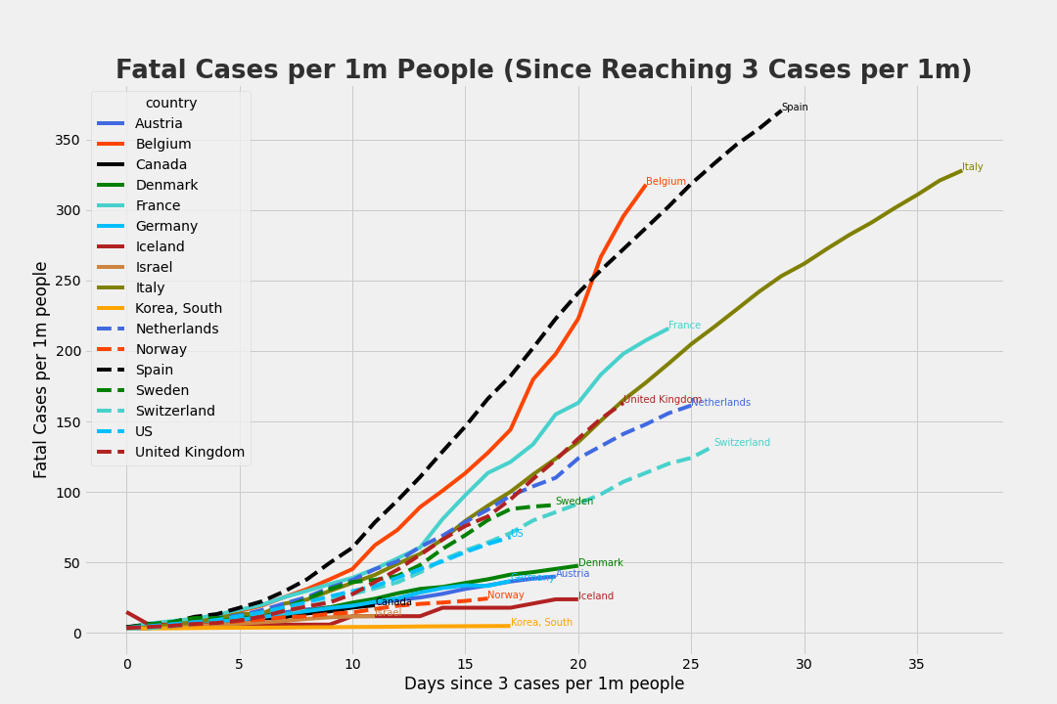
Fatal Cases per 1m People
Since Reaching 3 Cases per 1m

Slide 25
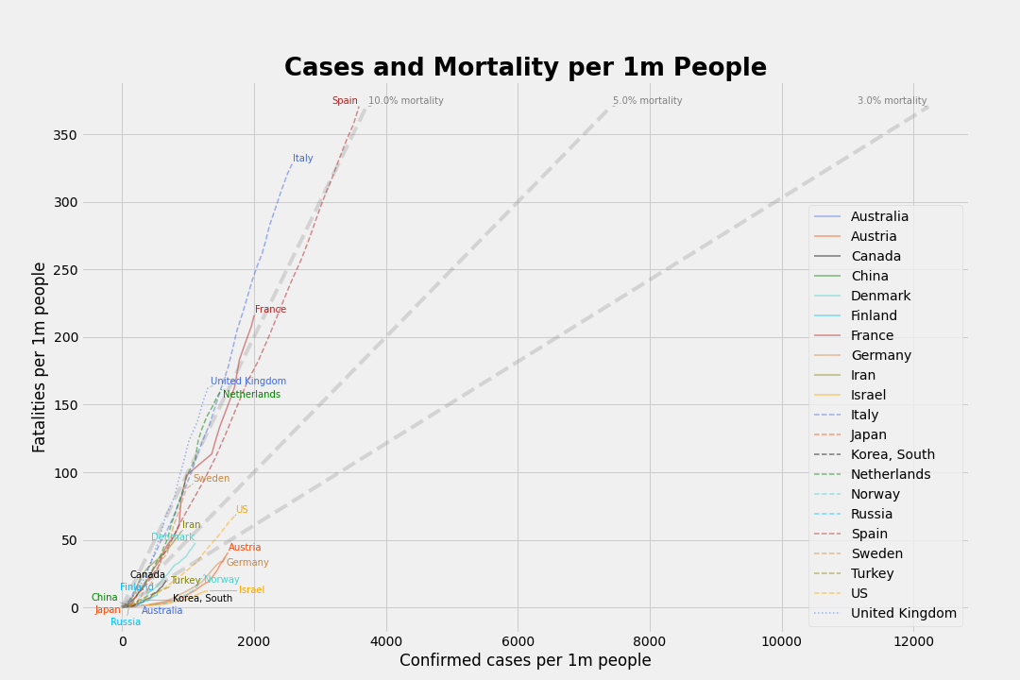
Cases and Mortality per 1m People

Slide 26
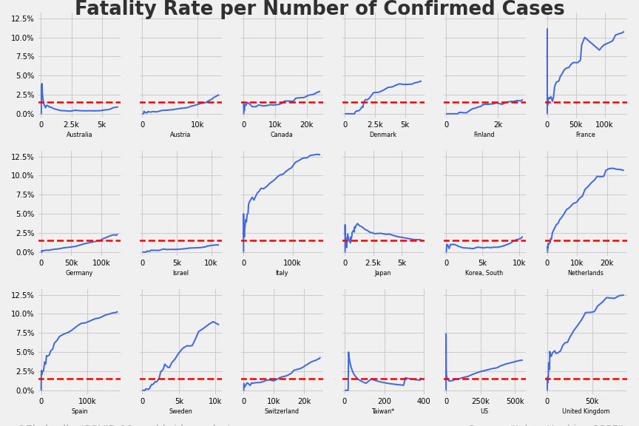
Incrasing number of cases vs mortality rate

Slide 27
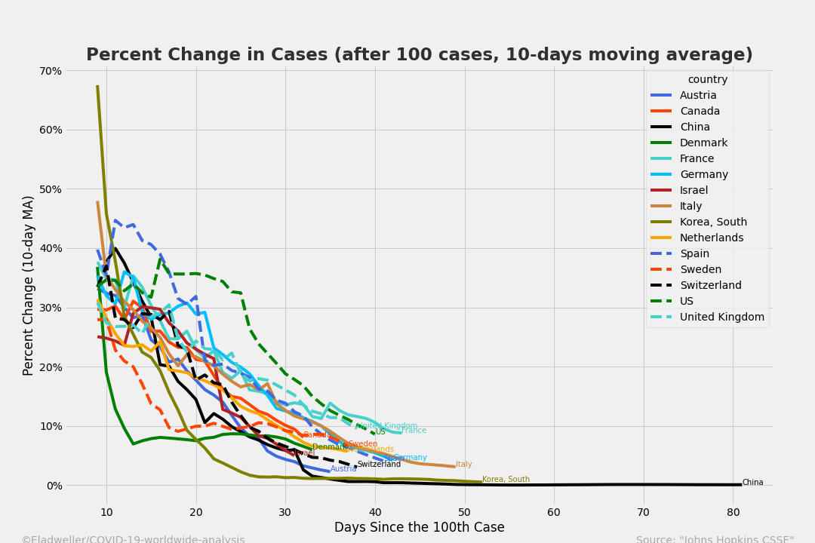
Percent Change in Cases
Since the 100th case, 10-days moving average

Slide 28
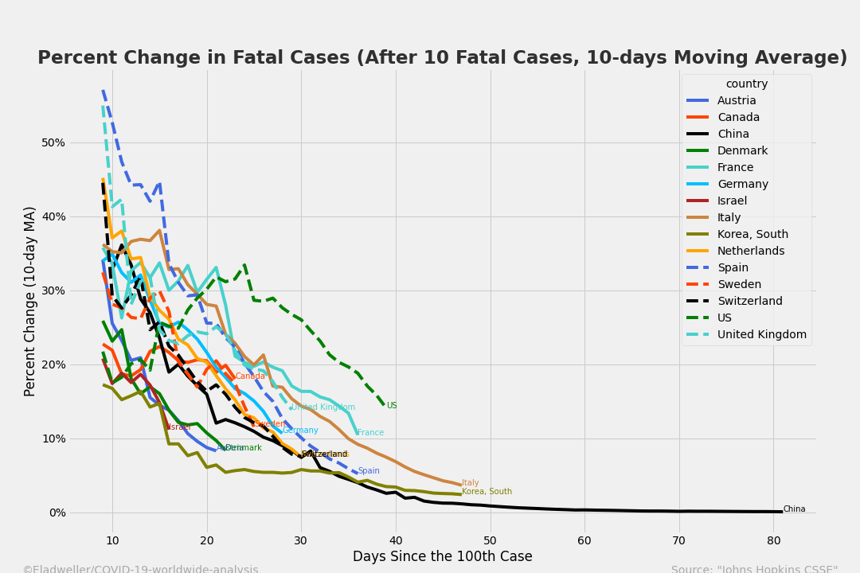
Percent Change in Fatal Cases
After 10 Fatal Cases, 10-days Moving Average

Slide 29
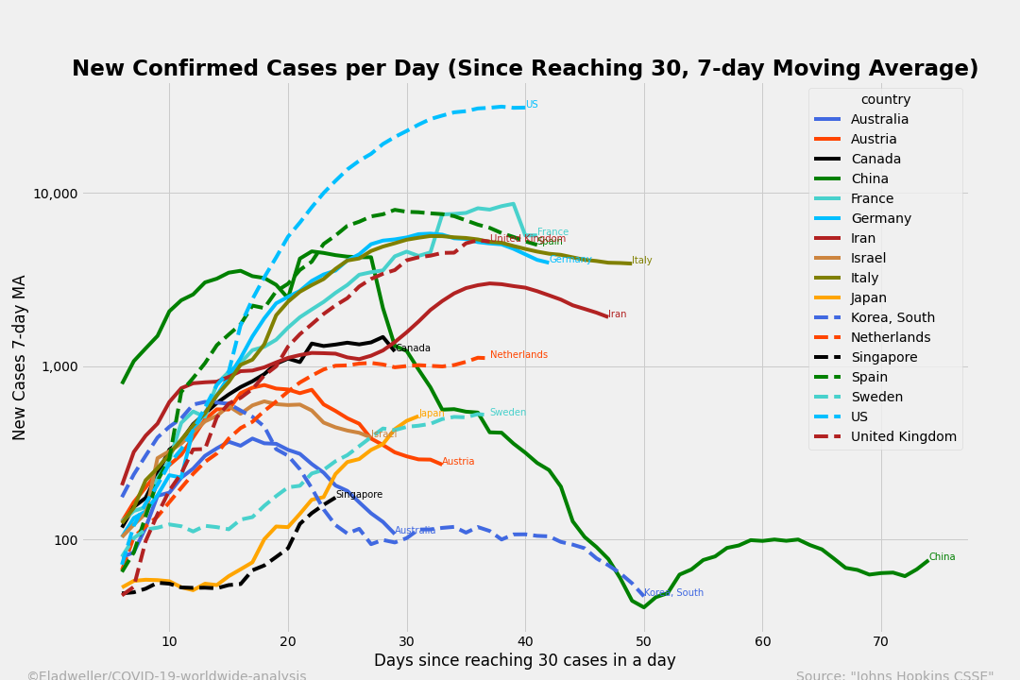
New Confirmed Cases per Day
Since Reaching 30, 7-day Moving Average

Slide 30
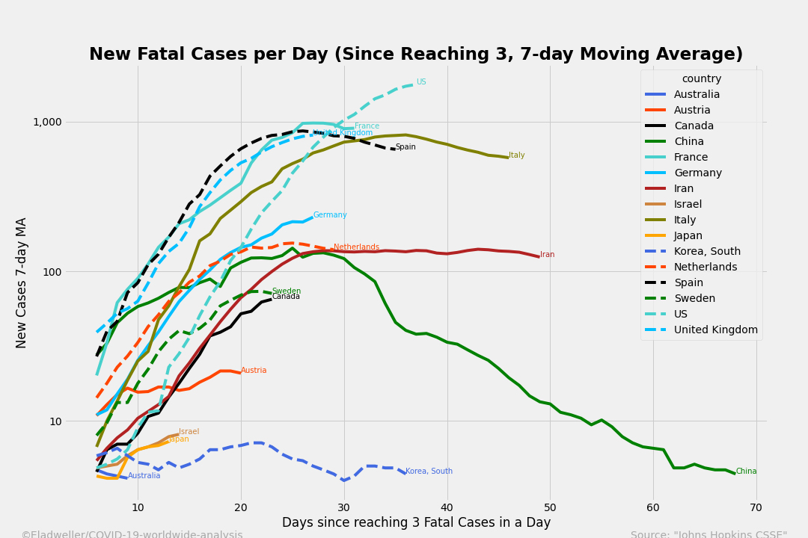
New Fatal Cases per Day
Since Reaching 3, 7-day Moving Average

Slide 31
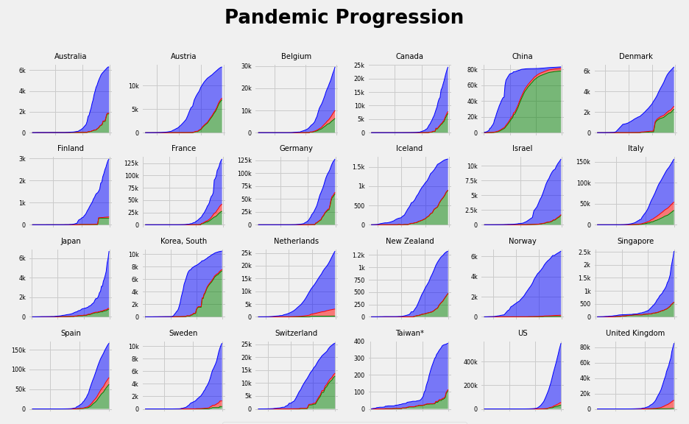
Pandemic Progression

Slide 32
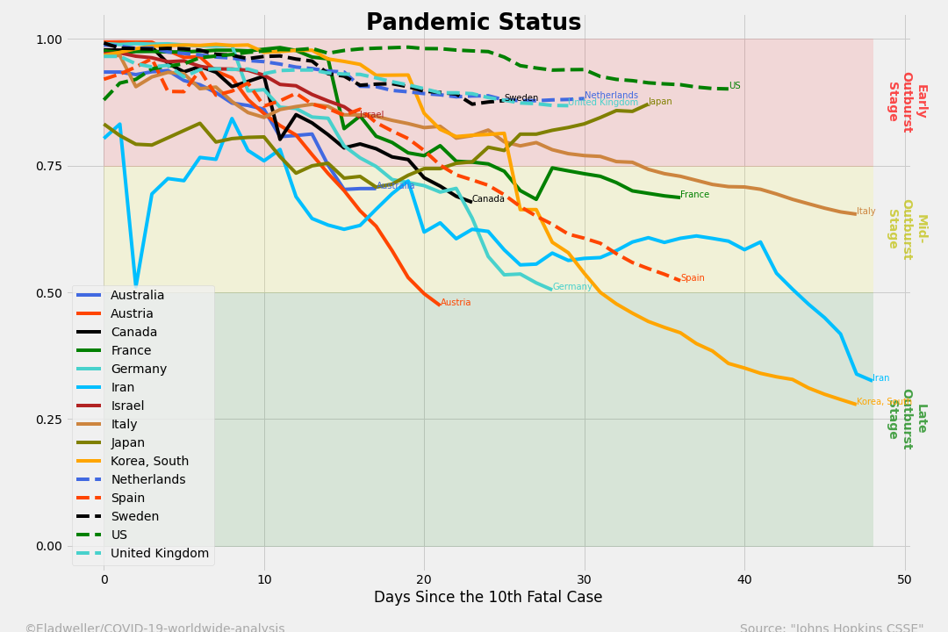
Pandemic Status
Active Cases as a Percentage of Total Cases

